Slide 1
Rahin Mon S
Bachelor of Technology
Information of Technology
211521205116
3/21/2024 Annual Review

Slide 2
PROJECT TITLE
Species Classification of wildlife using random forest
3/21/2024 Annual Review

Slide 3


AGENDA
Introduction
Project Overview
Implementation Details
Additional Processes
Demonstration
Conclusion & Discussion
3/21/2024 Annual Review

Slide 4

PROBLEM STATEMENT
Develop a comprehensive analysis pipeline for classifying zoo animals based on their attributes, including features such as hair, feathers, eggs, and more. Utilize machine learning techniques to build a predictive model for classifying animals into different classes. Evaluate the model's performance using various metrics such as accuracy, F1-score, precision, and recall. Conduct an in-depth exploratory data analysis to understand the distribution of animal classes and the prevalence of specific features among them. Explore feature importance to identify key attributes contributing to animal classification. Additionally, investigate relationships between certain features and animal behavior, shedding light on potential patterns or correlations. This analysis aims to provide insights into zoo animal classification and behavior, facilitating better understanding and management of zoo populations.
3/21/2024 Annual Review

Slide 5

PROJECT OVERVIEW
This project analyses dataset aims to classify species into different types using logistic regression.\\\
Data Exploration:
Load and explore the dataset.
Check for missing values and class distribution.
Visualization:
Visualize class distribution and feature distributions.
Pre-processing:
Handle missing values.
Encode categorical variables.
Scale numerical features.
Model Building:
Split data.
Build a logistic regression model.
Evaluate using accuracy, precision, recall, F1-score.
Fine-tuning:
Tune model hyperparameters.
Explore other algorithms for comparison.
Conclusion:
Summarize findings and model performance.
Discuss limitations and future work.
3/21/2024 Annual Review

Slide 6

WHO ARE THE END USERS?
Data Scientists / Analysts: Professionals who analyze and interpret complex data sets to inform business decisions or research findings. They would use this code to explore and visualize patterns, distributions, and relationships within the data, as well as to preprocess data for further analysis.
Machine Learning Engineers: Engineers responsible for designing, implementing, and deploying machine learning models. They would utilize this code to preprocess data, visualize class distributions, and potentially train and evaluate machine learning models on the dataset.
Researchers: Scientists or academics in fields such as biology, ecology, or zoology who study animal classifications and characteristics. They would employ this code to analyze and visualize zoo-related datasets, enabling them to identify trends or patterns in animal classifications or behaviors.
Students / Learners: Individuals learning about data analysis, machine learning, or related fields who seek practical examples and hands-on experience. They would study this code to understand common data analysis techniques, data visualization methods, and best practices in Python programming.
3/21/2024 Annual Review

Slide 7

YOUR SOLUTION AND ITS VALUE PROPOSITION
Reading Data:
Solution: Read the CSV file once with the correct path.
Data Concatenation:
Solution: Ensure you have distinct datasets to concatenate or remove the concatenation step.
Data Exploration and Visualization:
Solution: Ensure clarity in visualizations, label axes appropriately, handle missing values, and provide meaningful titles.
Modeling:
Solution: Utilize imported libraries to build a classification model, predicting the class type of zoo animals based on features.
Value Proposition:
Gain insights into class distribution and feature relationships for informed zoo management.
Automate class prediction for categorization and management purposes.
Improvements:
Properly handle missing values, outliers, and data preprocessing.
Evaluate multiple classification algorithms and perform feature engineering.
Implement cross-validation and visualize model results for better interpretation.
3/21/2024 Annual Review

Slide 8

THE WOW IN YOUR SOLUTION
Variable Naming: Ensure consistent and descriptive variable naming. For example, df and df2 could have more meaningful names like zoo_data1 and zoo_data2.
Plot Titles: Add titles to your plots using plt.title() to provide context and improve clarity.
Visualization Customization: Experiment with customizing your visualizations further by adjusting parameters like color palettes, plot sizes, and font sizes.
Data Cleaning: Check for and handle any missing or erroneous data appropriately before proceeding with analysis.
Data Sampling: Consider randomly sampling a subset of your data for faster analysis and visualization, especially if dealing with large datasets.
3/21/2024 Annual Review

Slide 9
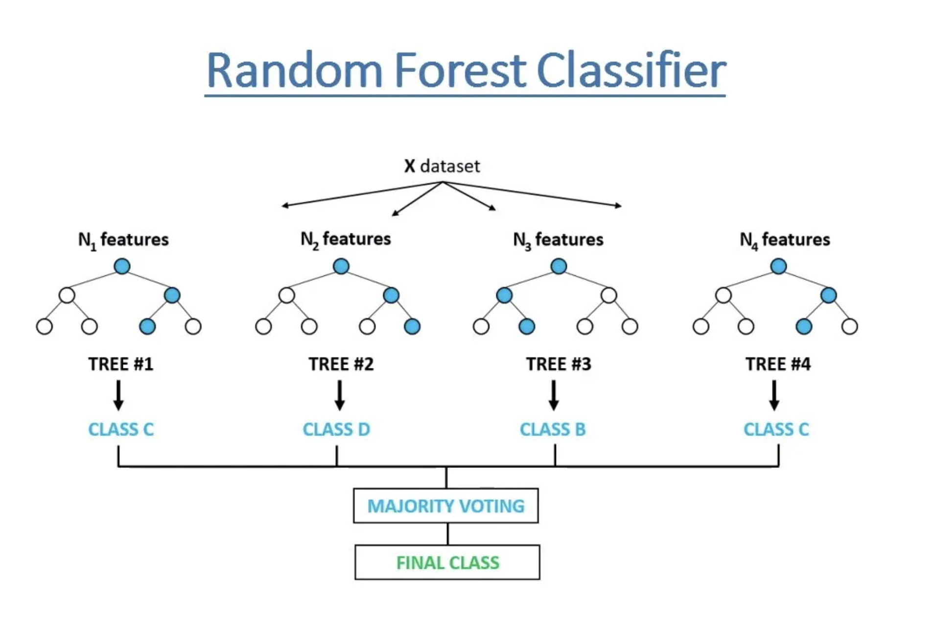
MODELLING

Slide 10
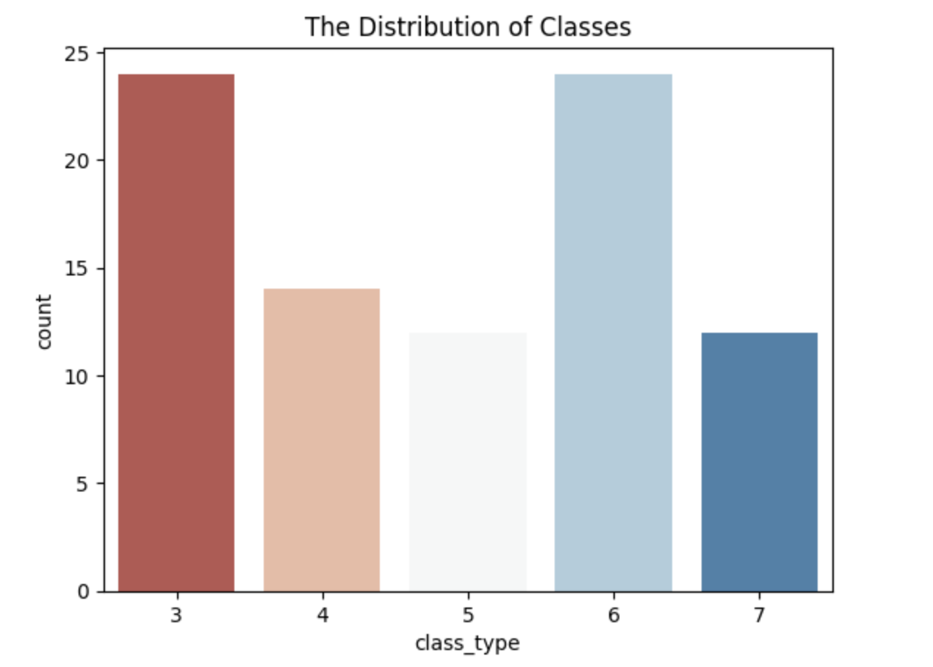
RESULTS
print(df3['class_type'].value_counts())
sns.countplot(data = df3, x = "class_type", palette = "RdBu")
plt.title("The Distribution of Classes")

